Slide 1
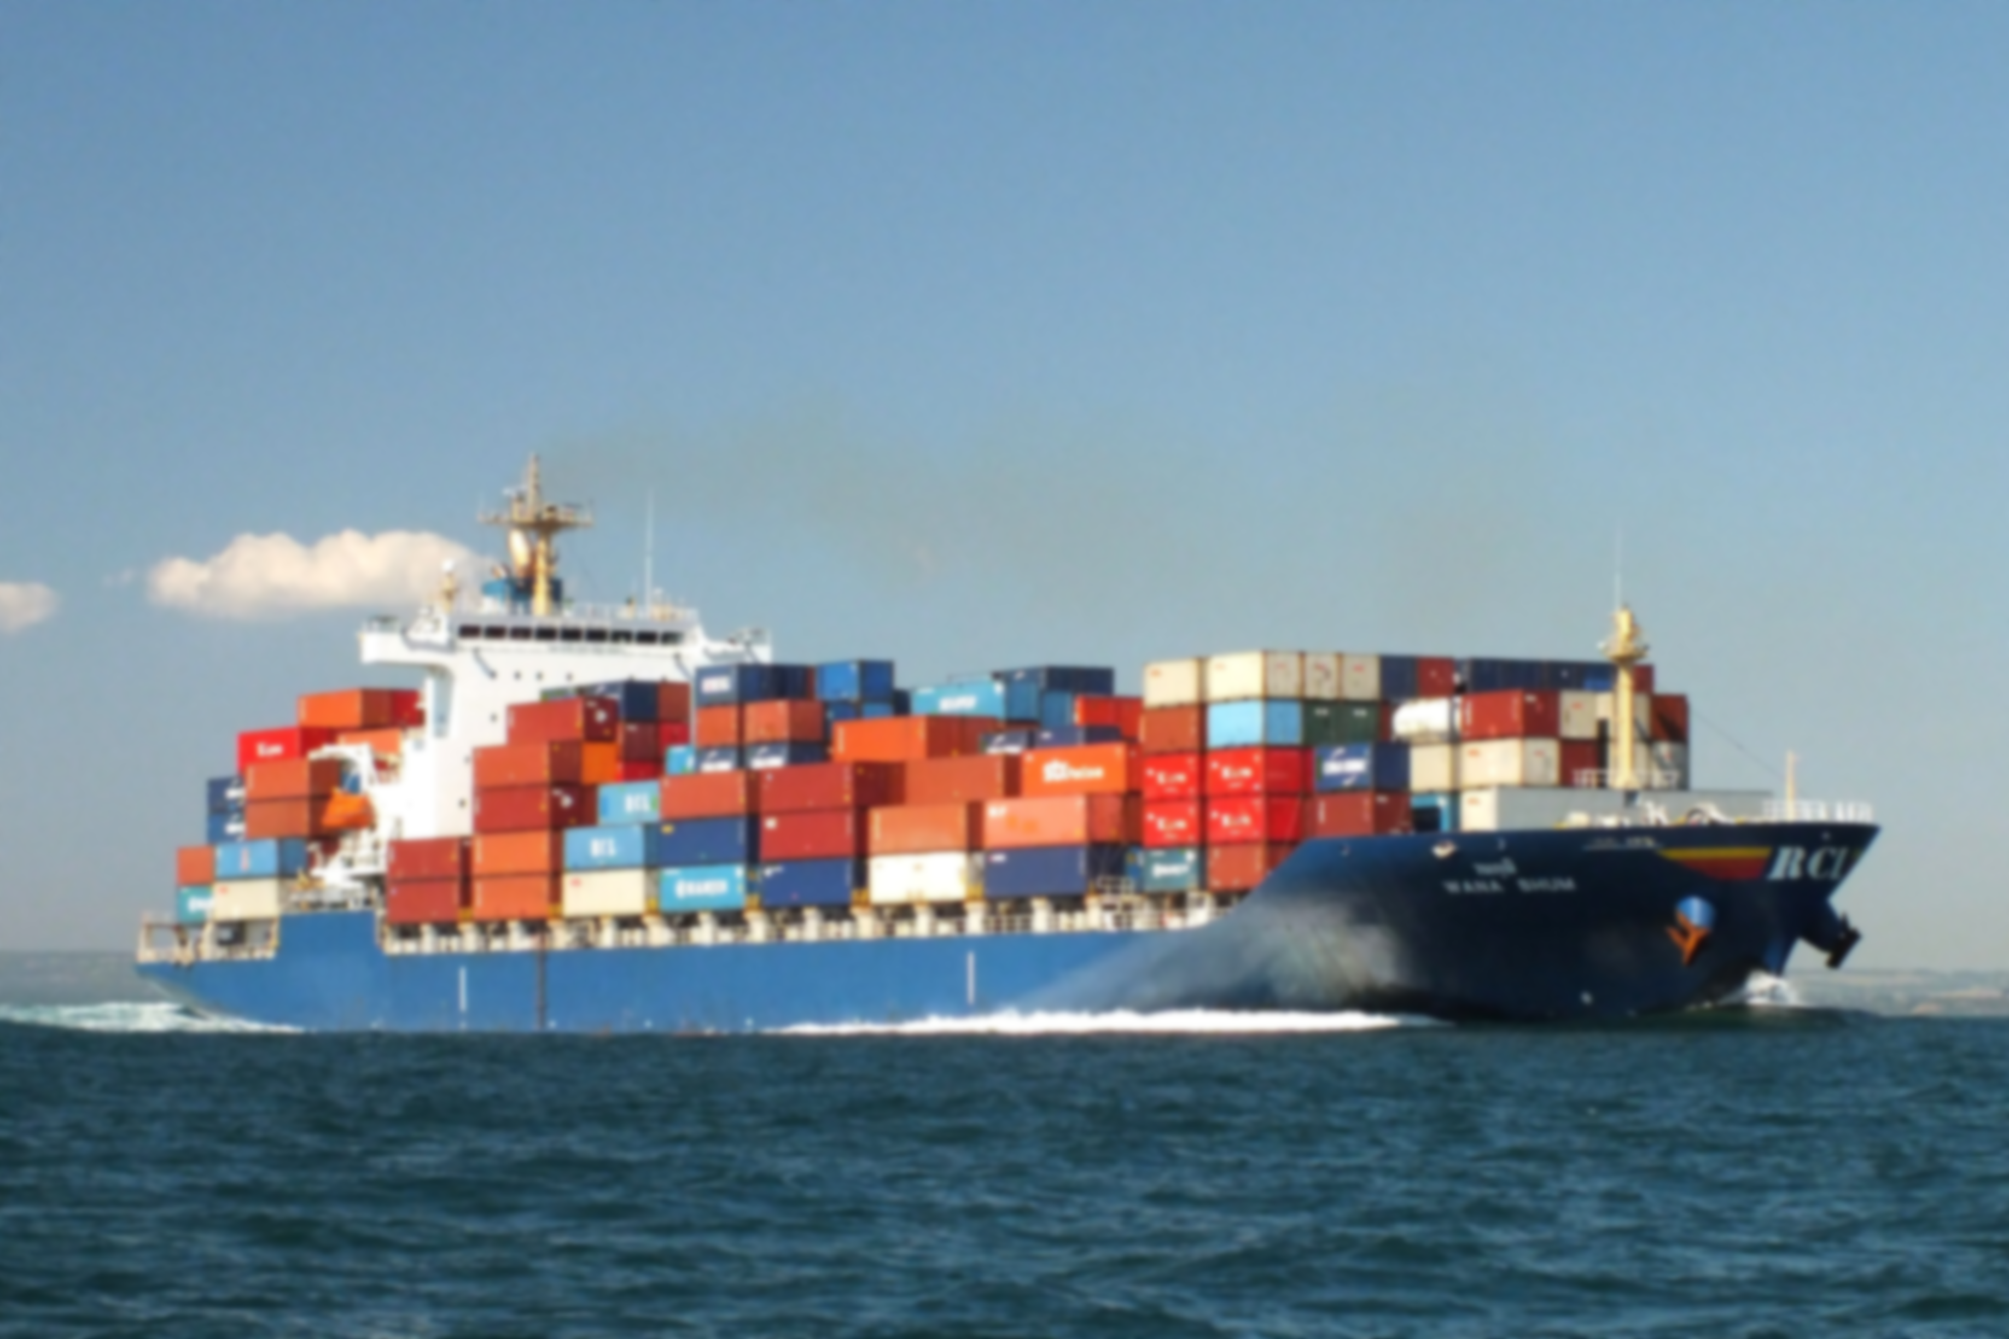
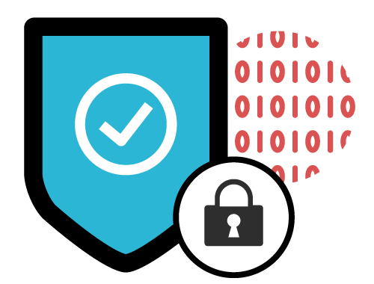
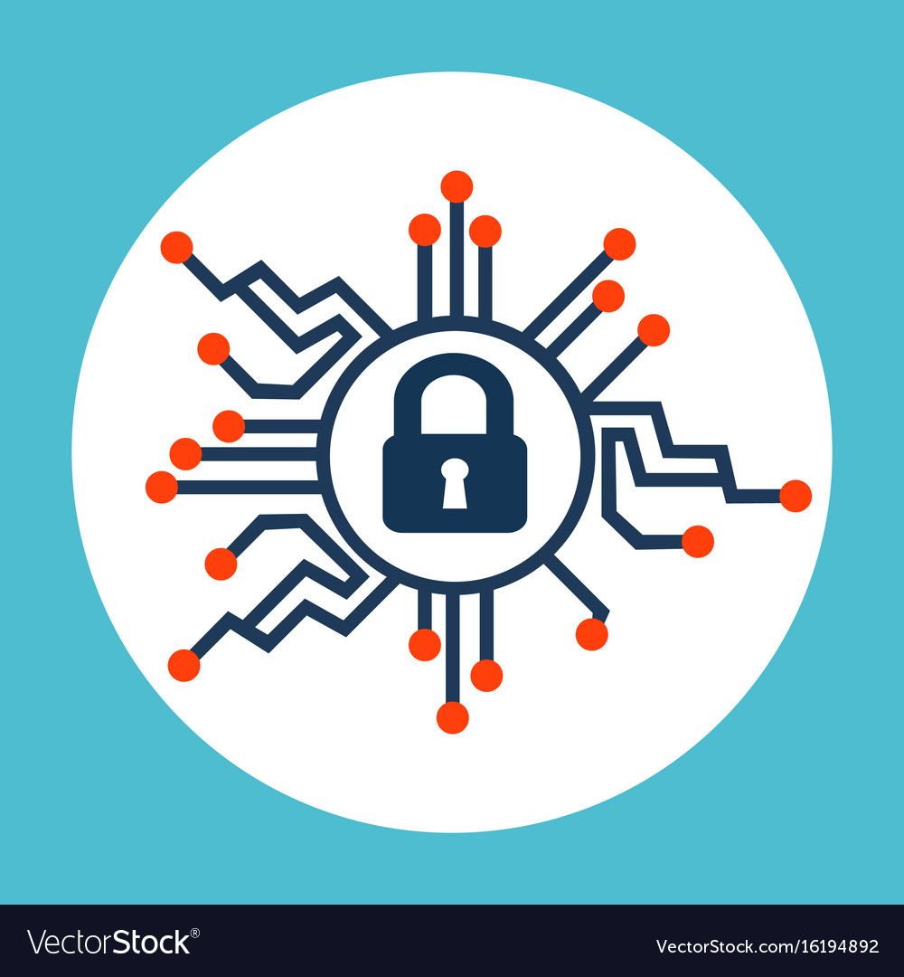
ENHANCING CYBER SECURITY AWARENESS IN MARINE INDUSTRY
PRESENTATION BY: Mihir Chandra

Slide 2
Scope
Cyber security is the combination of stakeholders, policies, processes and technologies to protect cyber assets of any industry.
WHAT is Cyber Security
Growing use of big data, smart ships, and IOT, is now increasing and therefore the amount of information are getting accessed by attackers of cyberspace. Hence the threats of unauthorised access or malicious attacks to ships systems and networks get greatly heightened
WHY is it Important
On average, hackers attack 2244 times a day (University of Maryland)
The aim of this paper is to develop understanding and awareness of key aspects of cyber security – identify threats, identify vulnerabilities, assess risk exposure, develop protection & detection measures & establish contingency plans.
To establish guidelines for operators on how to assess their ship’s operations & put in place necessary procedures and actions to maintain the security of cyber systems for marine industry.
Scope of the Paper

Slide 3
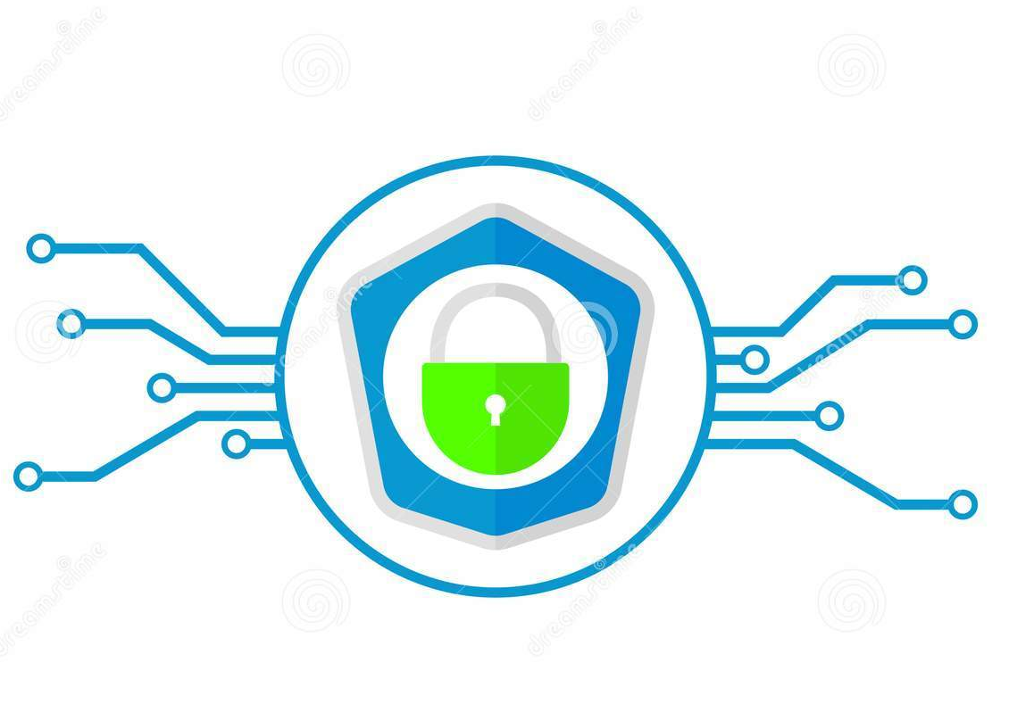
Cyber threat is real
Cybercriminals can hack any network in the world- all thanks to the technology of digitalization!
The crash rate can increase to 70%
Definition of “Risk”
In cyber security terms, Risk is the potential for a threat (a person or thing that is likely to cause damage) to exploit a vulnerability (a flaw, feature or user error) that may result in some form of negative impact (National cyber security center UK,NCSC)
Ships can be exposed to interference from one of the many electronic navigation devices i.e. The Global Positioning System which can cause serious trouble to the ship owners
Can be bugged with viruses in cargo work or in sensitive and seamless documentation
Risks in Shipping Industry
Can be bugged with viruses in the propulsion units of engine room or in machines

Slide 4
ObJective
To find out the factors which become a part for awareness and mitigation drive of cyber risk, threat, vulnerabilities in hindsight, at hand and as a foresight to be prepared for treading in uncharted terrains of new possibilities in shipping industry.

Slide 5
TYPES OF CYBER ATTACK
Phishing - sending emails to large numbers of people asking for sensitive information (such as bank details) or encouraging them to visit a fake website
Water holing - setting up a fake website or compromising a legitimate one in order to exploit visiting users
Ransomware - which could include disseminating disk encrypting extortion malware
Scanning - attacking wide swathes of the Internet at random
Untargeted
Attacks
For ships, untargeted attacks are one where a company or ship’s system and data are one of many potential targets

Slide 6
TYPES OF CYBER ATTACK
Spear-phishing - sending emails to targeted individuals that could contain an attachment with malicious software, or a link that downloads malicious software
Deploying a botnet - to deliver a DDOS (Distributed Denial of Service) attack
Subverting the supply chain - to attack equipment or software being delivered to the organisation
Vishing- voice phishing by adversial AI.
Targeted
Attacks
In a targeted attack, your organisation is singled out because the attacker has a specific interest in your business, or has been paid to target you. For ships targeted attacks are like the system or data being intended targets.

Slide 7
TARGETED ATTACKS
A targeted attack is often more damaging than an un-targeted one because it has been specifically tailored to attack your systems, processes or personnel, in the office and sometimes at home.
SYSTEMS or SERVICES or ACTIVITIES IN SHIPPING under threat
Administrative and crew welfare system:
Certificates in digital format, Seamen-identity document for example
Quarantine digital reports
Water ingress alarm system
Ballast water system
Gas liquefaction
ODMCS-GPS interdependency-compatibility
Various documents –E-bill of lading, E-logs, E-oil record books (forthcoming MEPC resolutions for MARPOL-to be enforce)
Passenger Services:
Property management system
Medical records
Passenger embarkation access control
User authentication and authorization system
Passenger or seafarer boarding with own device [BYOD]
Passenger Wi-Fi /-LAN internet access
Entertainment system
Communication
Other activities related to shore-side are also as below:
Berthing /Un-berthing activities
VTS-Pseudo VTS
Port related documentation-FAL Convention
C and F agencies
Port access control
Tanker and Gas terminals—safety, security, pollution related access, operation, spoofing.
Health related – Telemedic services

Slide 8
STAGES OF AN ATTACK
An attack, particularly if it is carried out by a persistent adversary, may consist of repeated stages. The attacker is effectively probing your defenses for weaknesses that, if exploitable, will take them closer to their ultimate goal.
Survey
Investigating and analyzing available information about the target in order to identify potential vulnerabilities
Delivery
Getting to the point in a system where a vulnerability can be exploited
Breach
Exploiting the vulnerability/vulnerabilities to gain some form of unauthorised access
Affect
Carrying out activities within a system that achieve the attacker’s goal
1
2
3
4

Slide 9
Measures to guard against cyber threats
The integration of technology in shipping operations is being enabled by the integration of Information Technology and the Operation Technology on board ships. This has enhanced the threats of unauthorised access or malicious interventions to ship’s systems and networks.
The integration of technology in shipping operations is being enabled by the integration of Information Technology and the Operation Technology on board ships. This has enhanced the threats of unauthorised access or malicious interventions to ship’s systems and networks.
Assessment of risks to safety, security, environment and commerce if no cyber security measures are in place
Due protection to IT and OT infrastructure and its connected and networked equipment
The measures to guard against cyber threats
Managing access
Protecting the data depending on its sensitivity

Slide 10
Tech Enablers of cyber security
4
Machine Learning and Deep Learning Algorithms
Data cut off & Parallel processing
2
Feature Extraction and Selection
5
Improving the performance of own security policy by removal of unnecessary data
Extending the use of Security Analytics for understanding and detecting risk level of vulnerabilities
3
1

Slide 11
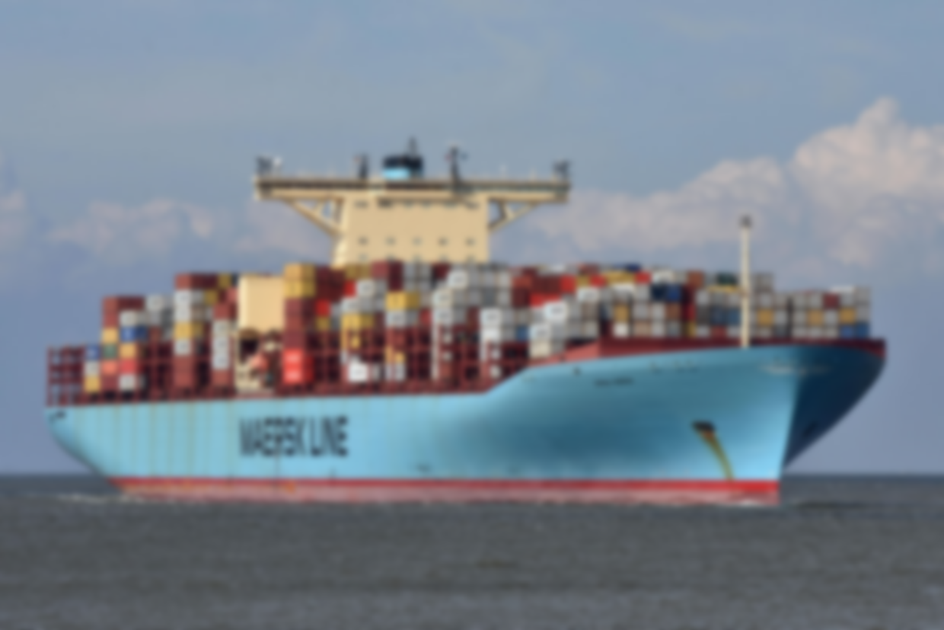
LITERATURE REVIEW
Marine Security professionals have additional resources to defend vulnerable networks and data from cyber attackers - combine the strength of artificial intelligence (AI) with cybersecurity.
According to a report published by Capgemini, about 42% of the companies studied had seen a rise in security incidents through time-sensitive applications.
Digital ship newsletter and ‘gcaptain’ article of 11th March 2020 has shown through Digital container shipping association’s publication named as DCSA cyber security implementation guide, the best practices –manageable task based approach towards meeting IMO resolution¹ MSC.428(98) implementation schedule for January 2021.
An article by H.A. Boyes suggests that 37% of data breaches were attributed to malicious and criminal acts. The remainder were split between system glitches (29%) and human factors (error/negligence) at 35%.
In 2017, on June 27, AP Moller-Maersk⁸ confirmed that the group was hit as part of global cyber-attack named ‘PETYA’, affecting multiple sites and select business units. The cost to company for recovery was about 200 to 300 million USD.

Slide 12
references
IMO resolution MSC.428(98) –Maritime cyber risk management in SMS.
Bhardwaj; (2018). Technology integration in shipping –potentials and challenges.ISBN:978-81-933569-6-8. ISF Institute of research and education, Mumbai.
UTNews. http://news.utexas.edu/2013/07/29/ut-austin-researchers-successfully-spoof-an 80-million-yacht at sea.
BIMCO. The guidelines on cybersecurity on board ships,2017
IHS fairplay, Maritime cyber security survey 2016
Hugh McDowell. Munin D 9.3: Quantitative Assessment 2015
Laguvardou.S. ‘Maritime cyber security concepts, problems and models, DTU Management engineering, University of Denmark
MAERSK.AP Moller A/S (22756214)2017
http://www.varonis.com/blog/cybersecurity statistics/
Boyce,H.A. , Resilience, security and risk in transport,2013,pp.56-63,The Institution of engineering and technology,Stevenge,UK,ISSN-2041-5923
Thesslstore.com/blog/AI-in-cyber-security-the savior
National institute of standards and technology, US Department of commerce.

Slide 13
RECENT HIKE IN CYBER CRIMES DURING CORONA TIMES
In the name of OLX-QR code indulgence of a fake identity of cyber fleecing through Google pay in August 2020
Another case https://www.facebook.com/mohitgaba/videos/336172004191265/
GST superintendent duped of INR 1.91 lac in KYC fraud in Mumbai- www.hindustantimes.com
Wfh has been more vulnerable as PC’s are open to threat comparatively to LAN or organizational unique set-ups.
So Govt, MHA advisory to take home for all netizens ,If any cyber frauds are met with —complaint at https://www.cybercrime.gov.in

Slide 14
TAKE CARE OF YOUR HEALTH AND CYBER HEALTH—GO FOR PHYSICAL IMMUNITY AND INVEST IN CYBER-IMMUNITY RESOURCES FOR OVERALL WELL BEING.

Slide 15
THANK YOU

